Slide 1
CSE 225
Recursion

Slide 2
Some Recursive Formulas
F(n) = F(n-1) + F(n-2)
F(n) = F(n-1) + 3n in which
F(0) = 2
What is the value of F(5)?
F(5) = F(4) + 3.5 = 32 + 15 = 47
F(4) = F(3) + 3.4 = 20 + 12 = 32
F(3) = F(2) + 3.3 = 11 + 9 = 20
F(2) = F(1) + 3.2 = 5 + 6 = 11
F(1) = F(0) + 3.1 = 2 + 3 = 5
F(0) = 2

Slide 3
Recursion Tree
47
F(5)
32
F(4)
3 * 5
+
20
F(3)
+
3 * 4
11
F(2)
+
3 * 3
5
F(1)
+
3 * 2
2
F(0)
+
3 * 1

Slide 4
Factorial (n) = n!
Factorial (n) = n * Factorial (n-1)
Factorial (1) = 1
Factorial (0) = 1

Slide 5
Finding a^{n}
a^{n} = a * a ^{n-1}
2⁵ = 2 * 2⁴
Power(a, n) = a * Power (a, n-1)
Power (a, 0 ) = 1
sum = 1;
for(i=1; i<= n; i++)
Sum = sum * a;

Slide 6
Recursion: Introduction
Most mathematical functions are described by a simple formula
C = 5 × (F – 32) / 9
It is trivial to program the formula
Mathematical functions are sometimes defined in a less standard form
ƒ(0) = 0 and ƒ(x) = 2ƒ(x-1) + x²
Then, ƒ(0) = 0, ƒ(1) = 1, ƒ(2) = 6, ƒ(3) = 21, …
A function that is defined in terms of itself is recursive, and C allows recursive functions

Slide 7
Example
Factorial: N! = N * (N-1)!
Fibonacci Number: F(n) = F(n-1)+F(n-2)
x^{n} = x × x^{n–1}
Traversing a Singly linked list and Printing keys
Traversing a Singly linked list and Printing keys in reverse order
Palindrome
Tower of Hanoi

Slide 8
Example: Factorial
Example: factorials
5! = 5 * 4 * 3 * 2 * 1
Notice that
5! = 5 * 4!
4! = 4 * 3! ...
Can compute factorials recursively using factorials
Solve base case (1! = 0! = 1) then plug in
2! = 2 * 1! = 2 * 1 = 2;
3! = 3 * 2! = 3 * 2 = 6;

Slide 9
Factorial
The following function computes n! recursively, using the formula n! = n × (n – 1)!:
int factorial(int n)
{
int t;
if (n <= 1)
t=1;
else
t=n * factorial(n-1);
return t;
}

Slide 10
Recursion

Slide 11
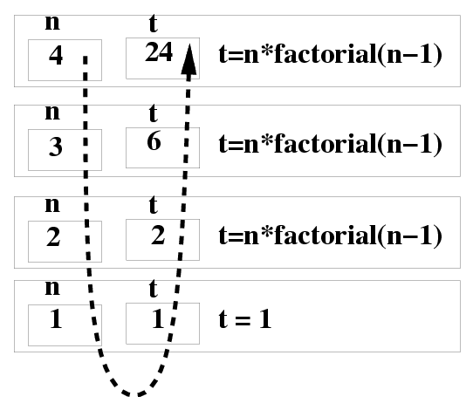
Factorial()
int factorial (int n) { | factorial(4) =
int t; | 4 * factorial(3) =
if (n <= 1) t = 1; /* BASE */ | 4 * 3 * factorial(2) =
else t= n * factorial(n-1); | 4 * 3 * 2 * factorial(1) =
return t; /* Make Progress */ | 4 * 3 * 2 * 1 = 24
}

Slide 12
Fundamental Rules of Recursion
Base Case: Must have some base cases which can be solved without recursion
Making Progress: for the case that are to be solved recursively, the recursive call always make progress toward the base case
If you do not follow the above rule, your program would not terminate
An Example of Non-Terminating Recursion
int BAD (int x) {
if (x==0) return (0);
else return( BAD( x/3 + 1 ) + x–1 );
}
main() { int y; y = BAD(1) + BAD(4);}

Slide 13
Example: Power of a Number
The following recursive function computes x^{n}, using the formula x^{n} = x × x^{n–1}.
int power(int x, int n)
{
int res;
if (n == 0) // base case
return 1;
else{ // making progress
res=x * power(x, n - 1);
return res;
}
}

Slide 14
Recursion
Both fact and power are careful to test a “termination condition” as soon as they’re called.
All recursive functions need some kind of termination condition in order to prevent infinite recursion.

Slide 15
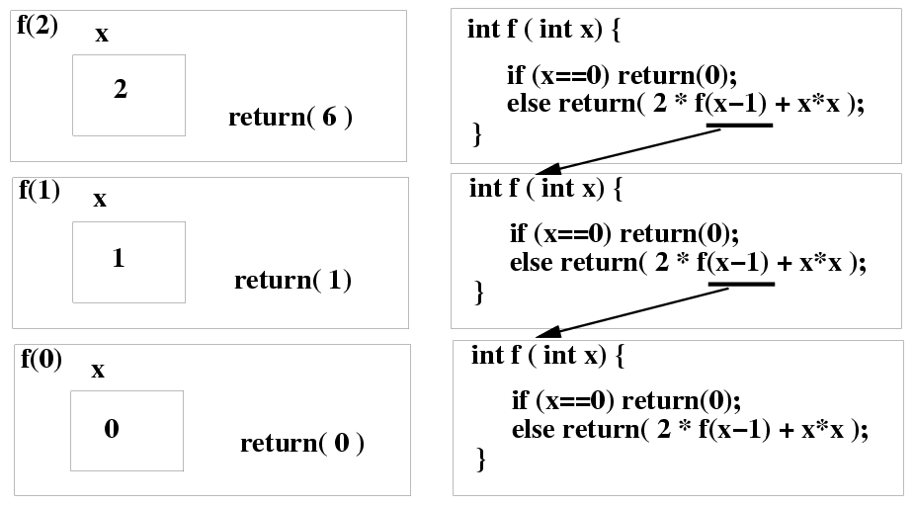
Recursive Functions: f(x)=2*f(x-1)+x²
A function that calls itself either directly of indirectly
int f (int x)
{
if( x == 0 ) return (0); /* Base Case */
else return( 2*f(x-1) + x*x ); /* Make Progress*/
}

Slide 16
Recursion Example: Fibonacci Series
Fibonacci series: 0, 1, 1, 2, 3, 5, 8...
Each number is the sum of the previous two
Can be solved recursively:
fib( n ) = fib( n - 1 ) + fib( n – 2 )
Code for the fibonacci function
long fibonacci( long n )
{
if (n == 0 || n == 1) // base case
return n;
else
return fibonacci(n-1) +fibonacci(n–2);
}

Slide 17
Example Using Recursion: The Fibonacci Series
Set of recursive calls to function fibonacci
f( 3 )
return
f( 2 )
+
f( 1 )
return
f( 1 )
+
f( 0 )
return 1
return 1
return 0

Slide 18
Recursion vs. Iteration
Repetition
Iteration: explicit loop
Recursion: repeated function calls
Termination
Iteration: loop condition fails
Recursion: base case recognized
Both can have infinite loops
Balance between performance and software engineering
Iteration achieves better performance (e.g., numerical computation)
Why? Function call involves lots of overhead
Recursion allows simple & efficient programming for complex problems, especially in non-numerical applications
e.g., quick sort, depth first traversal, tower of hanoi, ….

Slide 19
Example Problem: GCD
Determine the greatest common divisor (GCD) for two numbers.
Euclidean algorithm: GCD (a,b) can be recursively found from the formula

Slide 20
Problem: Decimal to Binary using Recursion
Write a function that will print binary equivalent of n
For example if n is 21 then binary equivalent is 10101

Slide 21
Solution
int convert(int dec)
{
if (dec == 0)
{
return 0;
}
else
{
return (dec % 2 + 10 * convert(dec / 2));
}
}

Slide 22
Fibonacci

Slide 23

The Tower Of Hanoi
Edouard Lucas - 1883

Slide 24
Once upon a time!
The Tower of Hanoi (sometimes referred to as the Tower of Brahma or the End of the World Puzzle) was invented by the French mathematician, Edouard Lucas, in 1883. He was inspired by a legend that tells of a Hindu temple where the pyramid puzzle might have been used for the mental discipline of young priests.

Slide 25
What does legend say??
Legend says that at the beginning of time the priests in the temple were given a stack of 64 gold disks, each one a little smaller than the one beneath it. Their assignment was to transfer the 64 disks from one of three poles to another, with one important proviso a large disk could never be placed on top of a smaller one. The priests worked very efficiently, day and night. When they finished their work, the myth said, the temple would crumble into dust and the world would vanish. How many moves ( & how long) would the priests need to take to complete the task??

Slide 26
Tower of Hanoi
A
C
B

Slide 27
Tower of Hanoi
Move 1: (1, A, C)
A
C
B

Slide 28
Tower of Hanoi
Move 2: (2, A, B)
A
C
B

Slide 29
Tower of Hanoi
Move 3: (1, C, B)
A
C
B

Slide 30
Tower of Hanoi
Move 4: (3, A, C)
A
C
B

Slide 31
Tower of Hanoi
Move 5: (1, B, A)
A
C
B

Slide 32
Tower of Hanoi
Move 6: (2, B, C)
A
C
B

Slide 33
Tower of Hanoi
Move 7: (1, A, C)
A
C
B

Slide 34
Example: The Tower of Hanoi
Recursive Solution: Divide and Conquer
The problem of moving n smallest disks from A to C can be thought of two subproblems of size n – 1
First, move the smallest n -1 disks from A to B
Then, move the nth disk from A to C
Finally, move the smallest n – 1 disks from B to C
The underlined subproblems can also be solved recursively
The base case is when n ≤ 0.

Slide 35
Sketch of the Algorithm
int i=1;
void hanoi(int n, char a, char c, char b) // a = from, b = aux, c = to
{
if (n == 1) {
printf(“n moves from %c to %c\n”, a, c); // moving disk n from source to destination
return;
}
if (n > 1) {
hanoi(n-1, a, b, c);
printf(“n moves from %c to %c\n”, a, c); // moving disk n from source to destination
i++;
hanoi(n-1, b, c, a);
}
}
main() {
int number;
printf(“Enter number of disks : ”);
scanf(“%d”, &number);
hanoi(number, ‘A’, ‘C’, ‘B’);
}

Slide 36
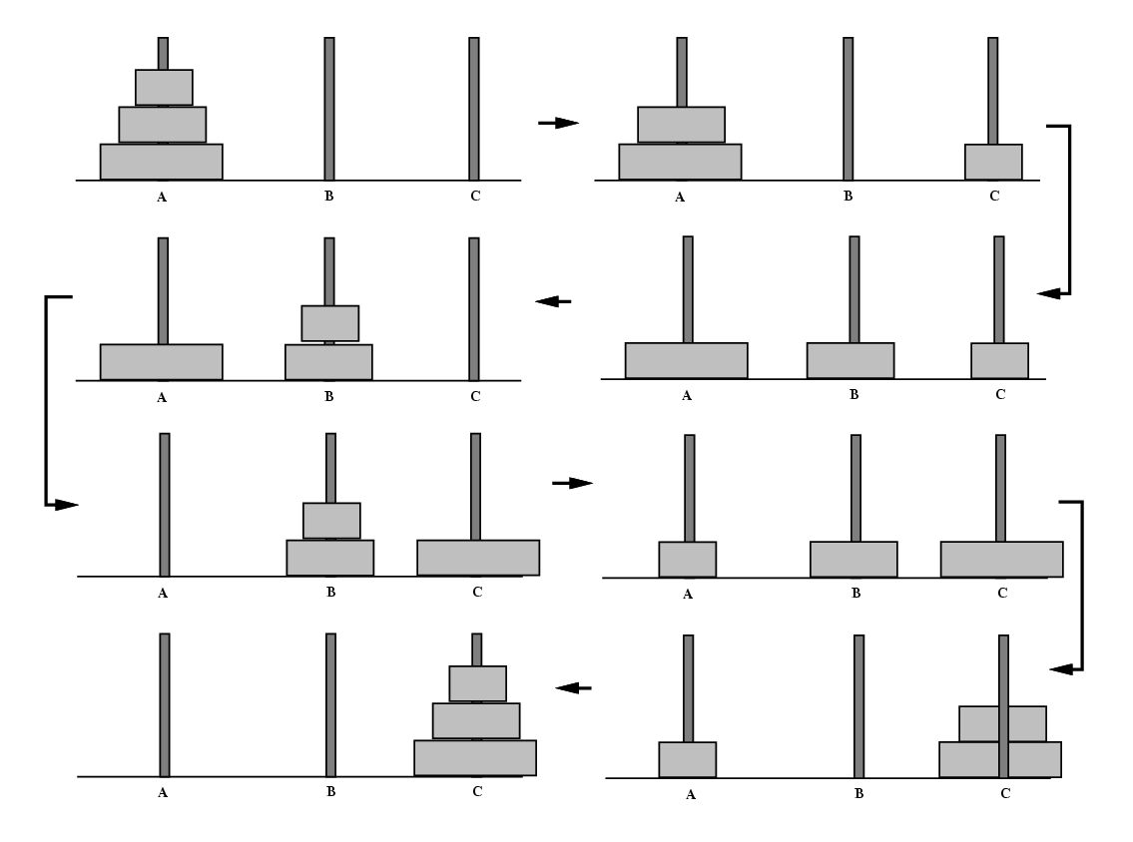
Tracing the Recursive Calls

Slide 37
Tower of Hanoi
Try it

Slide 38
Tower of Hanoi
Try it

